Slide 1



WebLadr
SMARTPLANNER
YOUR SIMPLE SMART DAILY PLANNER
Final Project Presentation
💻 JavaFX | 💡 OOP | 🗂️ Clean UX
Presented by Akib Khan

Slide 2

WebLadr
AGENDA
Introduction
How It Works
Meet the Developer
Final Project Presentation by Akib Khan
Tech Behind the Magic
Hi, I’m Akib Khan
Problem
Demo
The Road Ahead
Why Another Planner App?
Let’s See It in Action
What’s Next for SmartPlanner?
Solution
How to Get It
SmartPlanner: Lightweight. Simple. Effective.
Try It Yourself!
Thank You / Q&A
Thank You for Your Time

Slide 3


WebLadr
INTRODUCTION
SmartPlanner. It’s a simple, smart, and beautifully minimal desktop app built using JavaFX. Whether you're a student, professional, or just someone with too many things to remember, SmartPlanner helps you stay on top of your day — without overcomplicating your life.

Slide 4

WebLadr
PROBLEM
Everyone says “I’ll remember it,” but they don’t.
Sticky notes disappear.
Google Calendar is overkill for daily to-dos.
WHY ANOTHER PLANNER APP?

Slide 5
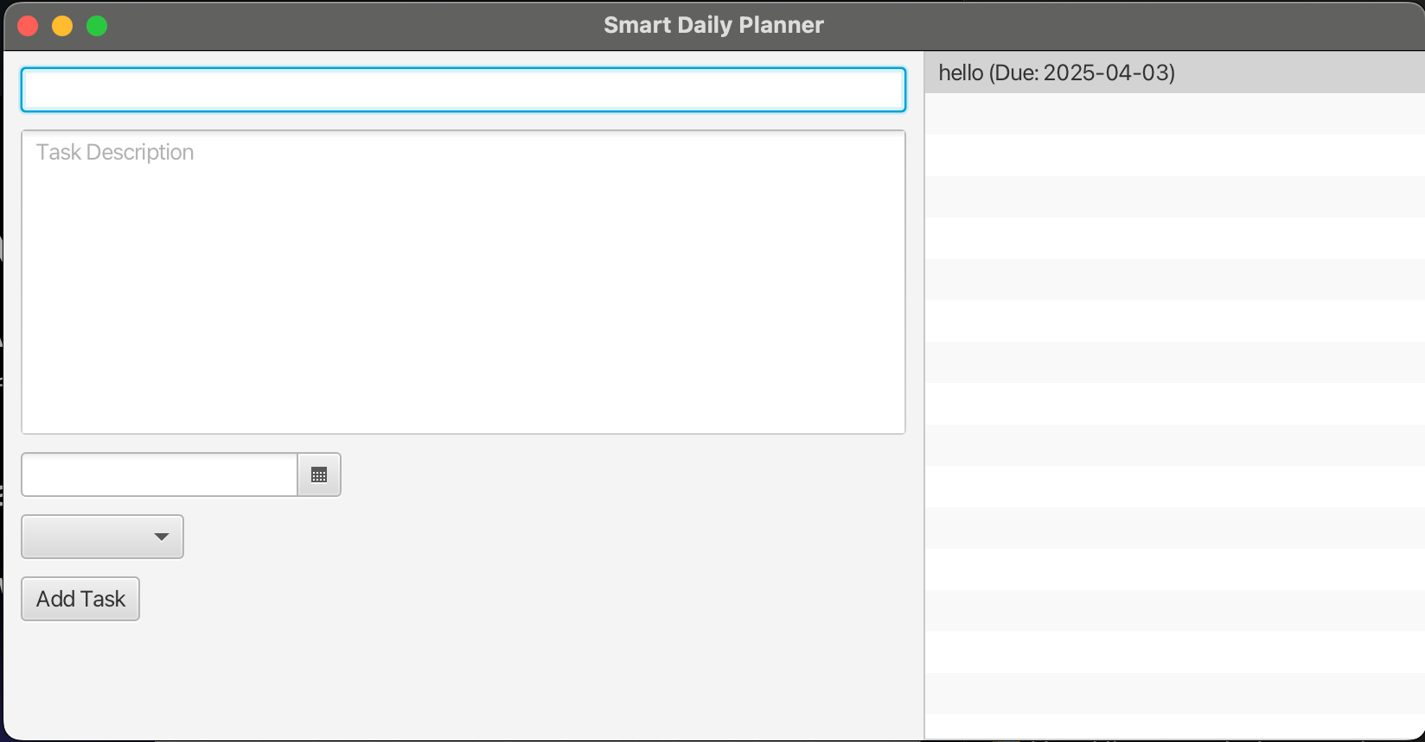
WebLadr
THE SOLUTION
INTRODUCING SMARTPLANNER
SmartPlanner: Lightweight. Simple. Effective.
Add Work, Study, or Personal tasks
Choose due dates with a few clicks
Simple enough to use.

Slide 6
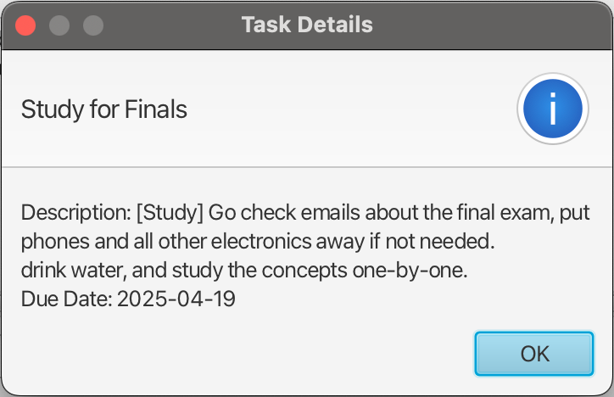
WebLadr
THE SOLUTION
INTRODUCING SMARTPLANNER
SmartPlanner: Lightweight. Simple. Effective.
View everything instantly
Click a task to reveal details
Data auto-saves — even if you don’t
Smart enough to remember.

Slide 7

WebLadr
HOW IT WORKS
Tech Behind the Magic
Frontend
JavaFX-based GUI
Clean layout using VBox, BorderPane, etc.
Click interaction for task details
Just pure Java and discipline.

Slide 8
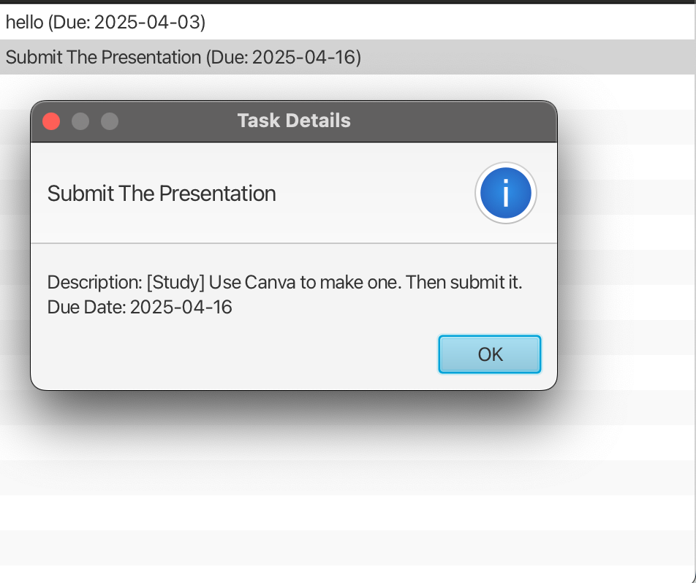
WebLadr
HOW IT WORKS
Tech Behind the Magic
Backend
Object-Oriented Design (TaskManager, Tasks)
Saves to tasks.txt locally
Category-specific classes: WorkTask, StudyTask, PersonalTask
No APIs. No AI.

Slide 9
WebLadr
DEMO
Let’s See It in Action
Fill the task form
Select a category & date
Click “Add Task”
View the task list
Reopen the app — boom, tasks are still there! 💾

Slide 10
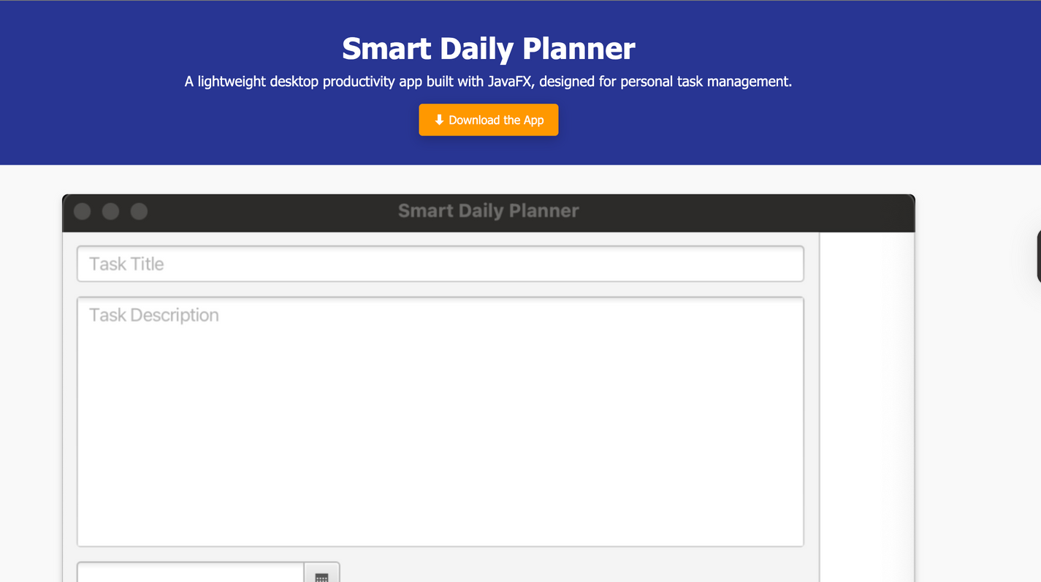
WebLadr
HOW TO GET IT
Options:
✅ Download .jar file (cross-platform)
🛠️ Or run from source on GitHub
Download from my website.
Built with Java 17. Not tested on cats.

Slide 11

MEET THE DEVELOPER
Hi, I’m Akib Khan
Lead Developer & Founder of WebLadr
Final year CS student
Lover of clean code, curious minds, and cricket
Proudly created SmartPlanner to simplify chaos

Slide 12
WebLadr
THANK YOU FOR YOUR TIME
Let’s connect 👇
Links-
Github- https://github.com/RashiduzzamanKhan4/final_project
WebSite- https://rashiduzzamankhan.com/smart-daily-planner/
LinkedIn- https://www.linkedin.com/in/rashiduzzamankhan18/
email- rkhan5@oakland.edu
Presented by Akib Khan

